Slide 1
Where Do You Stand?
Abdul Hye, PhD
281-488-3191
a6h@yahoo.com

Slide 2
Descendents of Abraham
Adam
Noah
Abraham
1900 BC
Issac
Ishmael
.
Torah
Hinduism
1500 BC
Moses
Judaism
1300 BC
Bible
Buddhism
525 BC
Jesus Christ
Christianity
4 BC
Quran
Muhammad
Islam
610 AD
2003 AD

Slide 3
World Population
Growth based on Last 50 Years*
 |  | (in millions)
 |  | Years
Item | Change* | 2002 | 2010 | 2015
Christian | 1.00% | 2100 | 2274 | 2390
Muslim | 2.90% | 1700 | 2137 | 2465
Jew | -0.10% | 15 | 15 | 15
Hindu | 2.10% | 820 | 968 | 1074
Buddhist | 1.20% | 370 | 407 | 432
Sikh | 2.00% | 25 | 29 | 32
Confucianist | -0.25% | 320 | 314 | 310
Shintoist | 2.10% | 70 | 83 | 92
Others** | 2.10% | 800 | 945 | 1048
World | 2.30% | 6220 | 7171 | 7858
**African, Communist, non-religious, etc
Comparative Chart
(Based on Last 50 Years)
Year | Christian | Muslim
1900 | 27% | 12%
2000 | 30% | 19%
2005 | 29% | 21%
2010 | 28% | 23%
2015 | 26% | 26%
2020 | 26% | 27%
2025 | 25% | 30%

Slide 4
World Muslim Population
World Muslim
Population
USA Population (280 m)
.
84% Christians (235 m)
18% Arabs
82% Non-Arabs
3.7% Muslims (10 m)
20% Africa
2.1% Jews (6 m)
10% Russia & China
10.2% Others (30 m)
17% South East Asia
30% India Subcontinent
Islam 2nd Largest Religion
% Muslim
13% other places of World
10% Turkey, Iran, Afghanistan
USA 3.7%
UK 4%
Canada 2%
The majority of all Muslims are not Arab
France 7%
Germany 3.5%

Slide 5
World Muslim Population Summary
Islam is the fastest growing religion in the world.
Every 4th person in the world is a MUSLIM.
1/3 of the countries in the world (58 out of 189) have over 50% population as Muslims.
Islam is the 2nd largest religion in US, UK, France, Canada, and Germany.
Today there are over 10 million Muslims in the USA.
There are over 4,000 Mosques in the US and Canada alone.
In the year 2015-16, Muslims in the world will be majority.

Slide 6
Common Views of Judaism, Christianity & Islam
1. Monotheism: Torah: “I am the first, and I am the last; and besides me there is no God” (Isaiah 44:6);
Bible: “The Lord our God is one Lord” (Mark 12:29); Quran: “He is God, The One and Only” (Quran 112:1).
2. Prophets: Muslims believe and accept all the Prophets mentioned in the Torah, the Bible, and the Quran.
3. Miraculous Birth of Jesus: Besides Christianity, Islam is the only religion on earth that accepts the miraculous birth of Jesus. Jesus is mentioned 25 times in the Quran.
4. The Highest Honor of Women is Given to Mary, the Mother of Jesus, in the Quran (chapter #19).

Slide 7
Common Views (contd…2)
5. Greetings: All prophets had customs to greet believers with the words: “Peace be with you”.
(‘Assalamualaikum’ for Muslims).
6. Taking Off Shoes: God ordered Moses to take off shoes (Exodus 3:5); “Put off shoes from your feet…”(Joshua 5:15). Muslims take off shoes when they enter Mosque.
7. Purification Before Prayers: “Moses…washed his feet…” (Exodus 40:31-32). “St. Paul…purified himself…went into the temple” (Acts 21:26). Muslim purify themselves before each prayer, 5 times a day.
8. Fasting: Jesus fasted 40 days. (Matthew 4:2).
Muslims fast one month each year during Ramadan.

Slide 8
Common Views (contd…3)
9. Humbling while Praying by Bowing Heads to the Ground: “Abraham fell his face…”(Genesis 17:3). “Moses…bowed his head…”(Exodus 34:8). “Jesus…fell on his face and prayed…” (Matthew 26:39).
Muslims bow their heads to the ground while praying.
10. Not Bowing to Statues / Images: “ Thou shall not..any graven image…(Exodus). Muslims do not bow to statues, images or anything except God.
11. Decoration of Trees: It is forbidden in Bible (Jeremiah 10:2-5). Muslim do not decorate trees.
12. Everlasting Covenant: God made everlasting covenants with Abraham and his descendents. Muslim still keep this covenant; they circumcise their sons at birth.

Slide 9
Common Views (contd…4)
13. Abraham ’s Son Ishmael : The name Ishmael was chosen by God Himself (Genesis 16:11).
Muslims respect Ishmael like Isaac as a son of Abraham.
14. Wine Drinking Prohibited: “…drink neither wine nor strong drink…”(Luke 1:15). Muslims do not drink wine or alcohol ever.
15. Pork Forbidden: God ordered Moses: “And the swine is unclean to you…”(Leviticus 11:7). Jesus never ate pork in his life. Muslims never eat pork.
16. Usury / Interest Forbidden: “Take thou no usury…” (Leviticus). “He has put not out his money to usury.” (Psalms 15:5). Interest is forbidden in Islam.

Slide 10
Common Views (contd…5)
17. Disapprove Homosexuality: “…the Lord rained upon Sodom and upon Gomorrah… He overthrew those cities…” (Genesis). Homosexuality is forbidden in Islam.
18. No Original Sin: “The son shall not bear the iniquity of the father…”(Ezekiel 18:20). Muslims believe that sin can not be transferred or inherited from person to person.
19. Accountability: “…every man shall receive his own reward…to his own labor” (1 Corinthians 3:8). Muslims believe that every person is accountable for his/her deeds and will be rewarded accordingly.
Muslims observe and maintain many
instructions from the Torah & Bible

Slide 11
How much do people know about Muhammad?
He is the Last Messenger from God till the Day of Judgment & his prophet hood is for the entire world.
He is God’s Messenger; He is not God in any way and therefore Muslims do not worship him.
He received the first message from God through Angel Gibrael at the age of 40. He spent 10 years in Makka & 13 years in Madina to preach Islam; he died at the age of 63.
During these 23 years, the Quran was revealed for mankind.
Muhammad was an ordinary person with family and children; he was leader of a nation and a teacher.

Slide 12
The Prophecies of Holy Books/Torah
References about Muhammad in the Old Testament (2000 years ago)
1. God Blessed Abraham: Muhammad came from the progeny of Abraham through Ishmael (promised by God).
2. The Rejected Stone: Jesus spoke of the kingdom of God being taken away…given to the rejected stone… (Genesis 21:13-18). The rejected stone is the nation of Ishmael, the nation of Muhammad.
3. First Revelation: "… Read this…he said, I am not learned" (Isaiah 29:12).
Historical Facts: Angel Gabriel delivered first revelation: "Read…name of your Lord, who created man..." (Quran 96:1). Muhammad replied: “I am not learned".

Slide 13
The Prophecies of Holy Books/Torah (contd…2)
4. Prophet from Arabia: "Arabia, and all the Princes of Kedar...“ (Ezekiel 27:21)
Historical Facts: Many converts migrated to Madina; Muhammad migrated in 622AD. Next year 1,000 Makkans marched against the Muslims.
5. A Prophet Like Moses: God said to Moses, "I will raise up a Prophet… like unto thee. I will put my words in his mouth, & he shall speak them all...” (Deuteronomy18:18)
Historical Facts: Angel Gabriel used to bring revelations from God to Muhammad - thus God put “His words in Muhammad's mouth” (John 16:13, Isaiah 28:10). "He does not speak of (his own) desire.." (Quran 53:3-4).

Slide 14
The Prophecies of Holy Books/Torah (contd…3)
6. Prophet Gave Laws: "...He will not fall or be discouraged till…established justice in the earth…" (Isaiah 42:1-4).
Muhammad came with a complete code of laws. In spite of persecution and physical assaults, he was never discouraged nor expressed despair.
7. Prophet with 10,000 Saints: “…he came with 10,000 saints…right-hand went a fiery law..." (Deuteronomy 33:2)
Historical Facts: Muhammad returned to Makka with 10,000 devout followers & established the rule of law there.
8. Until Shiloh Come: Jacob told his children…”until Shiloh come…” (Genesis 49:10). Shiloh means “peace” (Islam).

Slide 15
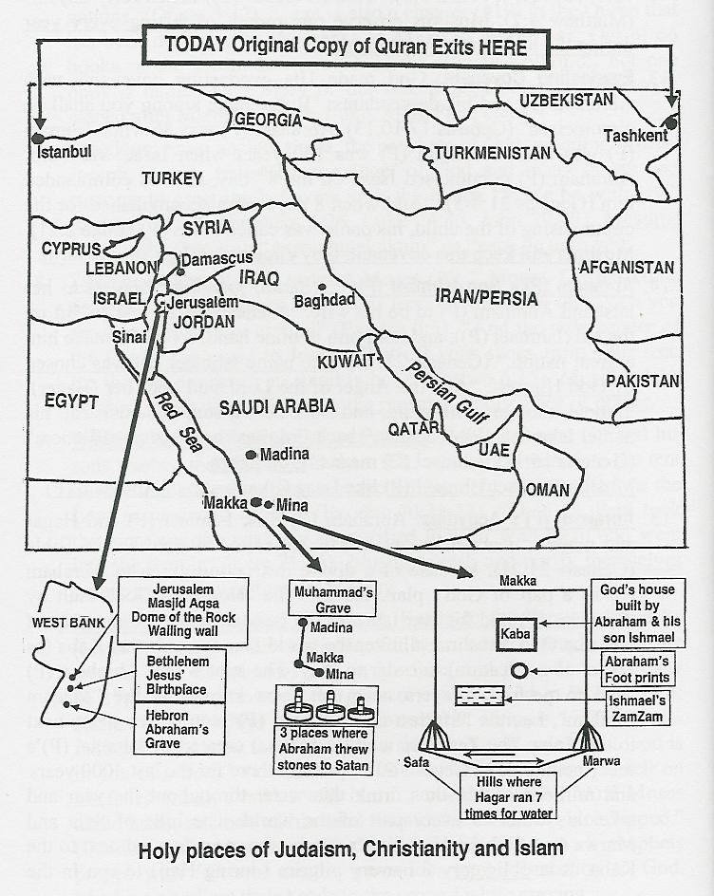
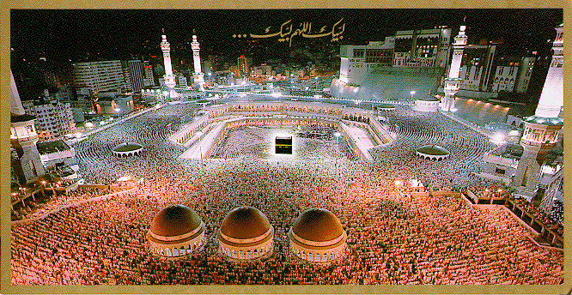
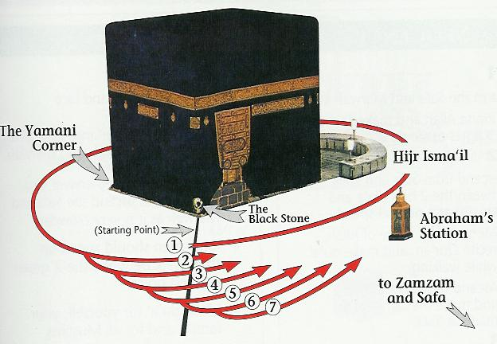
Abraham’s
Activities

Slide 16
The Prophecies of Holy Books/Torah (contd…4)
9. Pilgrims of Bacca Valley: “…they go through the valley of Baca; there it has a place of springs; the early rain also covers it with pools" (Psalms 84:5-6).
Makka is referred to as Baca (Quran 3:96). The famous ZamZam spring is located here. Makka used to get flooded.
10. Revealed Little By Little: “he teaches knowledge… line upon line; here a little, and there a little. (Isaiah 28:9-11)
Quran was revealed piece by piece over 23 years, scattered in the book “here a little, there a little”.
11. Prophecy By Name: Muhammad was quoted by name: "Cheeko mane tah kim, vechulo Mohamadim: his language is most sweet, & he is Muhammad“ (Song of Solomon 5:16)

Slide 17
The Prophecies of Holy Books/Torah (contd…5)
12. Prophecy Come To Pass: "When a Prophet speaks, if word does not come to pass or come true… word which the Lord has not spoken…”(Deuteronomy 18:22).
God informed Muhammad that the Romans would defeat the Persians (Quran 30:3). Chapter Rum of Quran was revealed at that time (615 AD) in support of Christians. The Romans won battle in 627AD.
Muhammad professed that the Muslims would soon conquer the Persian & Byzantium empires. At the battle of Yarmuk in 634AD, they defeated the Byzantine army, & at the battle of Madain in 637AD, they defeated the Persians.
Muhammad predicted many future events: overthrow of the Persian Empire & confiscation of the Emperor Choseros’s treasures; Suraqa, one of prophet’s companions, would be given the bracelets of Caesar. This happened.

Slide 18

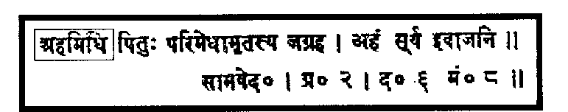
References About Muhammad in Hindu Scriptures
1. Verse 5 of Bhavishya Puran:“…His name will be Mahamad… Mahadev Arab… 'O Ye! The pride of mankind, the dweller in Arabia.“… (Prati Sarg Parv III).
2. Sama Veda, II, 6, 8: "Ahmad acquired religious law from his Lord. This law of religion is full of wisdom."

Slide 19
References About Muhammad In The Holy Bible
1. Jesus foretold about Muhammad: “…he shall give you another comforter…” (John 14:15-16)
2. Jesus said: “I have many things to say unto you, but you can’t bear them now…he will show you things to come…(John 16:14). The message of Jesus was incomplete. Another prophet was needed to guide mankind.
Gospel of Barnabas: “…Muhammad is his blessed name.” (Ch. 96-97)
All Holy Books Lead to Belief in
Muhammad & The Quran

Slide 20
The Holy Quran
1. The Quran is the collection of all revealed messages from God to Muhammad. It is memorized by millions of people even today.
2. Original copies still exist; one in Tashkent, Uzbekistan; the other in Istanbul, Turkey.
3. Sir William Muir, wrote: "There is probably in the world no other book which has remained 12 (now 14) centuries with so pure a text," (Life of Muhammad, Haykal).
4. Dr. Maurice Bucaille, a French Christian physician, compared scientific facts of the Bible & Quran. He found many scientific verses in the Quran; each of them is correct. He writes: "I could not find a single error in Quran”

Slide 21
The Holy Quran (contd…2)
5. Many scientific facts, unknown to man 1400 years ago, were revealed in the Quran. Each of them is proven to be scientifically correct (a few examples:)
The 'Big Bang' theory of Creation of the Universe
Planets and orbital patterns of the Cosmos
Conception and stages of embryological growth (‘The Developing Human’, Prof. Keith Moore, Uni. of Toronto)
Reference to fingerprints
How was it possible for an “unlettered” person to reveal the scientific mysteries 1,000 years ahead when no man on earth had any knowledge of them?

Slide 22
Gospel of Barnabas
1. Barnabas was a very close companion of Jesus. The Bible refers to him as an "apostle" (Acts 14:14), "a good man, full of the Holy Spirit and of faith" (Acts 11:24).
2. In 325AD, the followers of St. Paul gained control at the council of Nicea and made the following changes:
It canonized the 4 Greek Gospels that are read today.
All other Gospels including Gospel of Barnabas were ordered to be destroyed.
The only Gospel written in Aramaic, the language that Jesus spoke, was also destroyed.

Slide 23
Verses from the Gospel of Barnabas…
Jesus said: “God one hath no equal…He hath no father nor mother; he hath no sons, nor brethren, nor companions…”
Jesus said: “… I am man, born of mortal woman, subject to the judgment of God, suffering the miseries of eating and sleeping, of cold and heat, like other men. When God shall come to judge, my words like a sword shall pierce each one that believes me to be more than man.”
The priest asked Jesus: 'Art thou the Messiah of God….?’ Jesus answered: ‘…indeed I am not he…and (he) shall come after me …for God himself gave him the name …Muhammad is his blessed name”
Gospel of Barnabas is the Truth from Jesus

Slide 24
Islam: The Final Religion
Islam is the universal religion for all mankind.
'Islam' means submission to the will and law of God.
The other meaning of the word is peace (through God).
A Muslim willingly submits to the will and laws of God.
5 Pillars of Islam
Faith
Prayer
Fasting
Poor Due
Pilgrimage

Slide 25
The Five Pillars Of Islam
Faith: in the existence of the One & Only God: Sole Creator of the universe. He is Everlasting, All-Powerful, All-Knowing, Self-Sufficient, & Self-Sustaining.
Faith in all the Prophets of the past, and acceptance that Muhammad is the last Prophet.
Faith in all the Revealed, Unaltered, Holy Books of God.
Faith in the Angels of God.
Faith in life after death and the Day of Judgment.
Faith in Divine Decree (fate).
Prayer: During prayer, one seeks forgiveness, help, and guidance from God directly.

Slide 26
The Five Pillars of Islam (contd…2)
3. Fasting: Ramadan fasting is obligatory…..refrain from food, drink, and sex from before sunrise to after sunset.
4. Poor Dues: Pay annually 2½% of his cash savings and liquid assets (such as gold, silver etc.) to his less fortunate fellow human beings.
Pilgrimage: Travel to Mecca to worship God at the Kaba & Arafat to mark the occasion when Abraham was willing to sacrifice his son (Ishmael) (Genesis 22:2).
This is an obligation at least once in a lifetime, if financially and physically able to do so.
Every male wears two pieces of white unstitched cloth to cover the body and perform all the rituals. (Women wear their usual attire).

Slide 27
What Does Islam Say About…
Human Rights: Privacy, freedom, dignity, & equality are guaranteed in Islam. God says: "There is no compulsion in religion." (Quran 2:256).
Universality of Islam: God says: “We have sent you (Muhammad) as a mercy for all nations” (Quran 21:107).
"Whoever oppresses any non-Muslim, I shall be his prosecutor on the Day of Judgment." (Muhammad).
Jihad means any effort in the path of God. Constant struggle against the evil desires within oneself is Jihad.
If an Islamic state is attacked, it is the duty of all Muslims to defend themselves from the attack. This is Jihad.
Jihad is never meant to force anybody to choose a particular religion. An unjust effort or war cannot be called Jihad.

Slide 28
Women's Rights
Women’s rights and honor are not always respected -- rape, murder, frequent divorce, domestic violence, single parent homes, low moral and family values, abortion, prostitution, drugs, loss of peace in society, etc….still exist.
Women dare not walk on a dark street or even across an empty parking lot alone.
http://www.letswrap.com/dvinfo/stats.htm
95% of the victims of domestic violence are women. (DOJ)
Every 9 seconds a woman is assaulted and beaten. 4 women are murdered every day by their boyfriends or husbands.
4,000,000 women a year are assaulted by their partners.
Family violence kills as many women every 5 years as the total number of Americans who died in the Vietnam War.

Slide 29
Status & Responsibility of Women in Islam
Islam enjoins morality in behavior and appearance. Fashions that reduce women to sex objects are not acceptable.
Islam gave women the right of inheritance and independent ownership.
Women can seek employment. Muhammad’s first wife was a successful business woman.
Protection of Women's Honor: “…who launch a charge against women...produce four witnesses…" (Quran 24:4).
Muhammad said: “…treat your women well and be kind to them for they are your partners and committed helpers".
“The best of you are those who are kindest with your wives"
“….generous who are good to women, and…wicked who insults them".

Slide 30
Status and Responsibility of Women in Islam…2
Status of Mother: “A man asked Muhammad: 'Whom should I honor most?' The Prophet replied: 'Your mother'. 'And who comes next?' asked the man. The Prophet replied: 'Your mother'. 'And who comes next?' asked the man. The Prophet replied: 'Your mother!’ 'And who comes next?' asked the man. The Prophet replied: 'Your father’”
Marriage: “…He created for you mates from among yourselves… dwell in tranquility with them and He has put love and mercy between your hearts…" (Quran 30:21).
Independent Identity: A married woman in Islam retains her independent legal personality and her family name. She is not the property of her husband in any way!

Slide 31
Status and Responsibility of Women in Islam…3
Wife’s Property: From the 7th century, a woman does not need to present gifts (dowry) to attract potential husband.
The groom must present the bride with a marriage gift. The bride retains her marriage gift even if she is later divorced.
She is never obliged to act as a co-provider for the family unless she herself voluntarily chooses to do so.
Divorce: Islam discourages divorce, yet recognizes the rights of both partners to end their matrimonial relationship.
"Live with them on a footing of kindness and equity…" (Quran 4:19).
"A believing man must not hate a believing woman. If he dislikes one of her traits he will be pleased with another". (Muhammad).

Slide 32
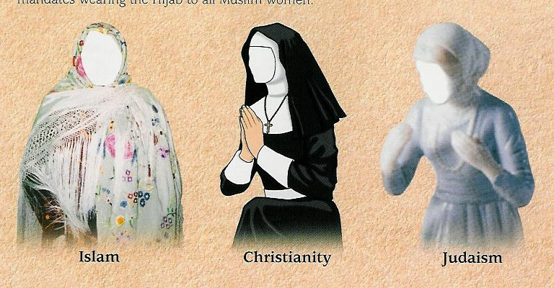
Status and Responsibility of Women in Islam…4
The Veil: "O Prophet, tell your wives and daughters and the believing women that they should cast their outer garments over their bodies so that they should be known and not molested" (Quran 33:59).
Islamic veil is a means of protection from unwanted attention.

Slide 33
Polygamy
Polygamy in the West: Serial polygamy: marriage, divorce, marriage, divorce, etc; a married man with one or more girlfriends; an unmarried man with a number of girlfriends.
Polygamy addresses orphans and widows in society.
Billy Graham, the Evangelist said: “Islam has permitted polygamy as a solution to social ills… Christian countries make a great show of monogamy, but actually they practice polygamy.… Islam is a fundamentally honest religion…”
Many non-Muslim and Muslim countries have outlawed polygamy. Cheating on the wife or using women without taking responsibility are common.
Is the law designed to reward deception and punish honesty?
Nearly 4 out of 5 who accepted Islam in the USA are Women.

Slide 34
Some Famous Quotes About Muhammad
Bernard Shaw (British philosopher): “… the Savior of Humanity…..if a man like him were to assume the dictatorship of the modern world, he would succeed in solving its problems…” (The Genuine Islam).
Gandhi: “…it was not the sword that won a place for Islam.. It was the rigid simplicity… his absolute trust in God and in his own mission..” (Young India)
Michael Hart: "My choice of Muhammad to lead the list of the world's most influential persons…he was supremely successful on both the religious and secular levels." (The 100: A Ranking Of The Most Influential Persons In History).

Slide 35
The Rational Choice
Study different religions, compare them, and then make a rational choice.
Islam is the final religion of mankind till the last day of this world. God says: “We have sent you (Muhammad) as a mercy for all nations” (Quran 21:107).
“I (God) have perfected your religion for you…have chosen for you Islam as your religion” (Quran 5:3).
People often say that Islam spread by ‘the sword’. This is not true. There is no mention of the word ‘SWORD’ in the whole Quran. Only a few preachers went to Indonesia. Today it is the largest Muslim country.

Slide 36
The Rational Choice…2
There is not a single TV, Radio Station or a national newspaper owned or controlled by the Muslims in the USA. Islam is still the fastest growing religion in USA & Europe.
Those who accept Islam include priests, bishops, doctors, engineers, businessmen, writers, scientists, scholars, celebrities, inmates, and ‘ordinary’ people including a large percentage of women.
Muslim communities are growing in every city with over 4,000 mosques in USA and Canada alone.
Where do you stand?

Slide 37
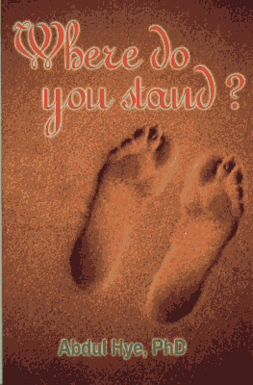

For More Information…
Madina Masjid, Inc.
P.O. Box 890071
Houston, TX 77289
Abdul Hye, Ph.D
281-488-3191
a6h@yahoo.com
www.islamicbooks4u.com

